Slide 1

Diabetes Mellitus Classification Analysis Team 8 Kohisha Aruganti Kowshik Bezawada Shumel Siraj Khan

Slide 2
Scope of the project
The objective of this project is to develop a machine learning model that can accurately classify patients as either having diabetes or not based on their medical data. The model will be trained using a dataset of patient information, and it will be used to predict the likelihood of a patient having diabetes.
In this presentation, we will guide you through the process of training Machine Learning models for Diabetes Mellitus classification on Amazon Web Services (AWS). We will use SageMaker to launch a Notebook Instance, which will be used to train the model. Finally, we will deploy the trained model and host a static webpage on S3. This webpage will contain the Jupyter Notebook in HTML format, which will allow others to reproduce the results and explore the model's performance.

Slide 3
Data Source :
The dataset is from Kaggle.
https://www.kaggle.com/competitions/widsdatathon2021/data?select=TrainingWiDS2021.csv
Dataset has 181 columns.
It consists of patient data from different hospitals indicating various heart health-related and other useful parameters.

Slide 4
Features that will be implemented
Data preprocessing and cleaning:
Ensure that the data is accurate and consistent by removing any duplicates, correcting errors, and handling missing values.
Feature selection:
Identify the most important variables that contribute to diabetes classification.
Select the subset of features that maximize model performance while minimizing overfitting.
Model selection and tuning:
Test different machine learning algorithms and adjust their hyperparameters to identify the most effective combination.
Model evaluation and interpretation:
Analyze metrics such as accuracy, precision, recall, and F1 score to assess the model's performance.

Slide 5
Cloud components
The project will leverage several cloud components to build, train, and deploy the machine learning model for diabetes classification. These components include:
Amazon S3:
Used for storing and managing the dataset.
Provides scalable, durable, and highly available storage for data.
Amazon SageMaker:
Used for building, training, and deploying the machine learning model.
Provides a fully-managed environment for machine learning workflows, including pre-built algorithms, frameworks, and development tools.
Amazon CloudWatch:
Used for monitoring the performance of the model and identifying issues.
Provides metrics, logs, and alarms to help users monitor resources and applications running on AWS.
Notes:
For storing data that will be used for training an SVM model, Amazon S3 would be a suitable storage option. Here's why:
Scalability: S3 is a highly scalable storage service that can handle large volumes of data, which is important for training an SVM model that requires a large dataset.
Cost-effective: S3 offers cost-effective storage options, including the ability to store data for as long as needed without incurring additional charges.
Data processing: S3 integrates with other AWS services, including Amazon Sage Maker, which is a managed service that provides an integrated environment for building, training, and deploying machine learning models, including SVM models. You can use Sage Maker to access and process data stored in S3, train your SVM model, and deploy it.
Data security: S3 provides a range of security features, including encryption, access controls, and audit logging, to help protect your data.

Slide 6

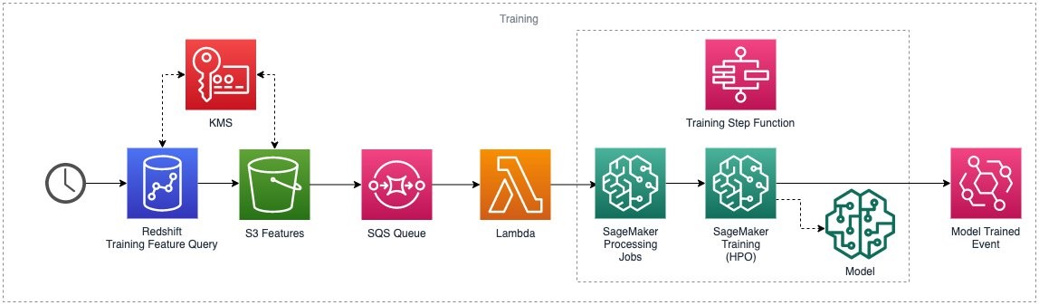
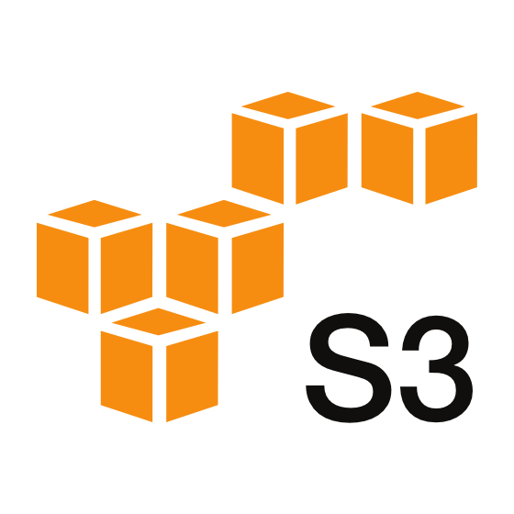

Logical Architecture
Data
HTML static website
Ingested data is stored
The trained model artifacts will be stored
Data processing and model training
Notes:
we are collecting data from Kaggle, which will be uploaded into an S3 bucket.
The data will then be preprocessed and cleaned using Sage Maker, and the features will be selected using Sage Maker Feature Store.
We will train our model using Sage Maker's built-in algorithms, and the performance will be evaluated using Sage Maker Model Monitor By utilizing Sage Maker's various tools and features, we aim to develop a robust and accurate model while ensuring data quality and monitoring the model's performance.
Finally, we will host a static webpage using an HTML file that showcases the results and exploratory data analysis of our project.
The static webpage will serve as a visual representation of our project's findings and insights for easy comprehension and dissemination.

Slide 7
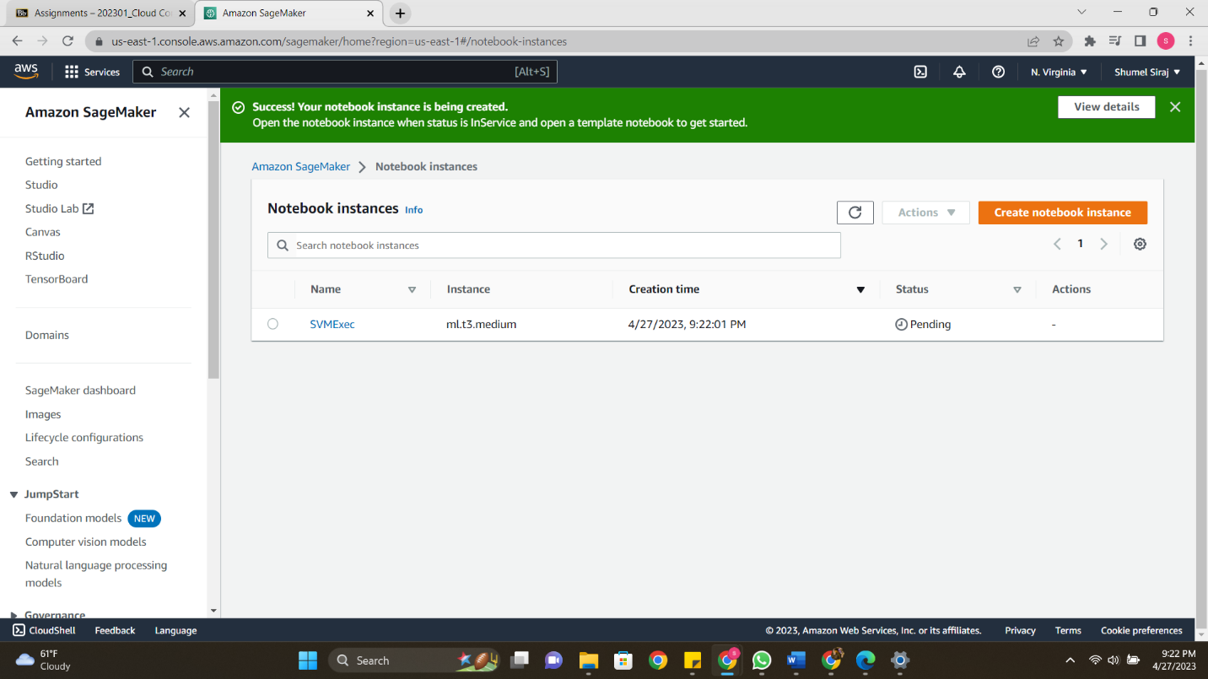
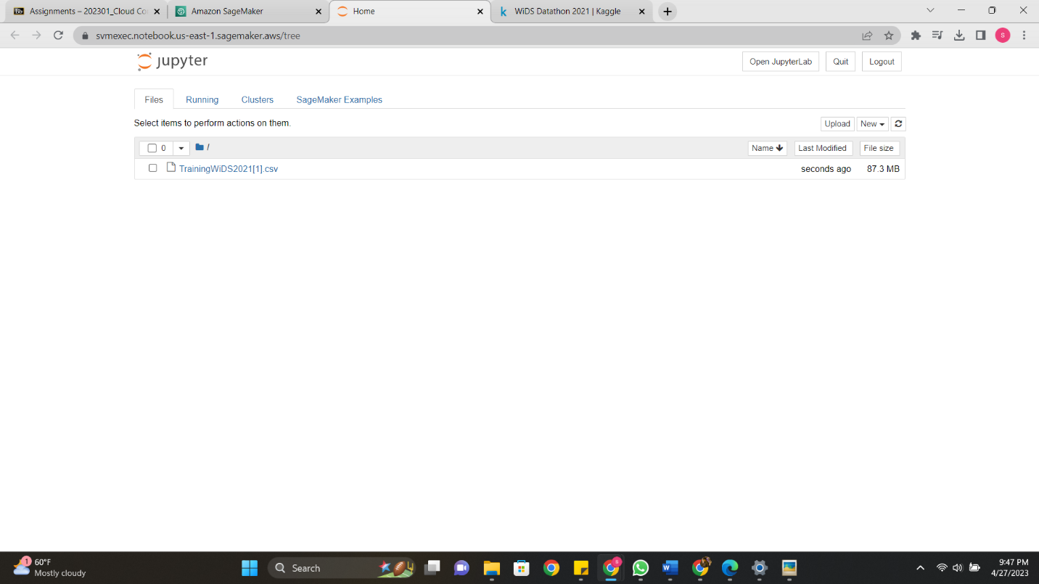
Creating a Notebook instance using SageMaker

Slide 8
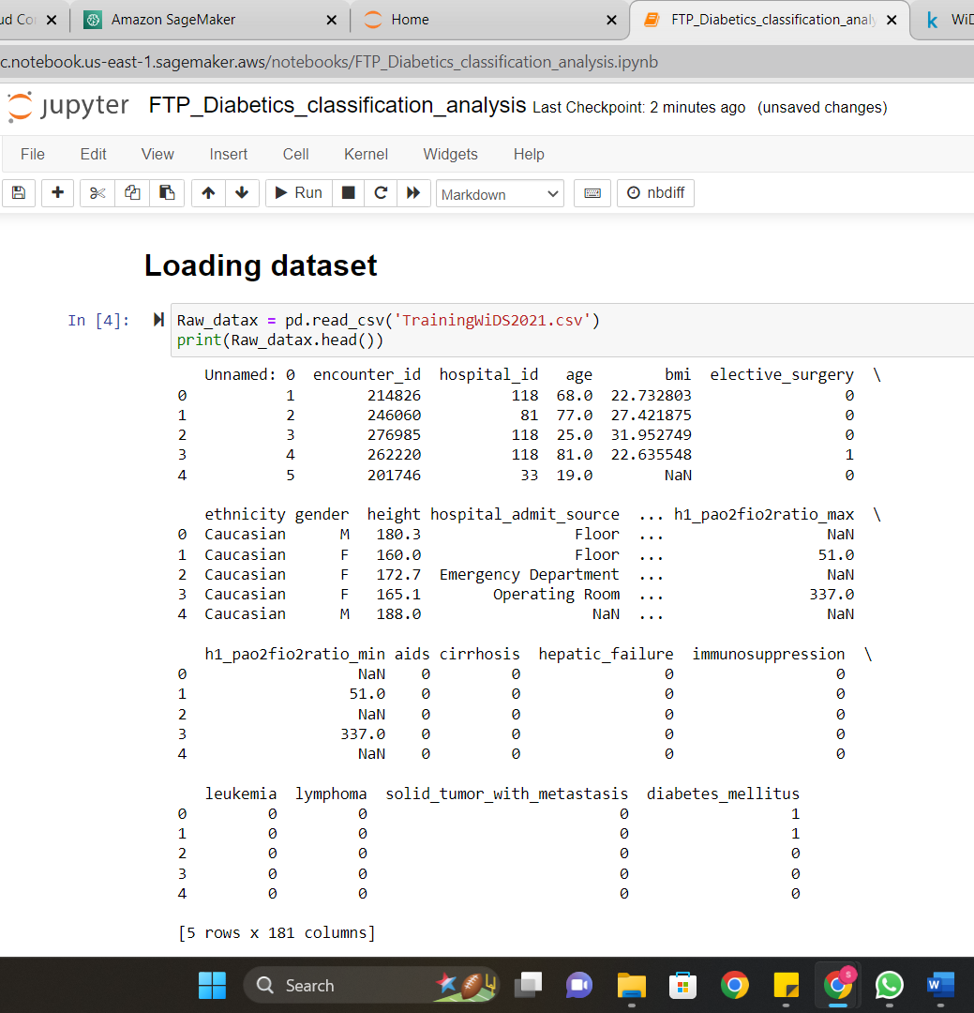
Loading Dataset on Jupyter Notebook
Initially the dataset has 181 columns. However, after understanding the dataset we have decided to narrow it down to 88 columns depending on their relationship with our target variable.
Then the patient dataset now has 130157 records and 88 attributes. These attributes are further segregated to list of ids, binary, categorical and numerical columns as follows based on their datatype. We have 3 categorical columns, 12 binary columns, 2 ID's, and the rest are numeric.

Slide 9
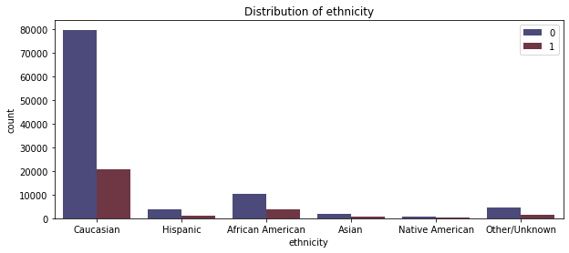
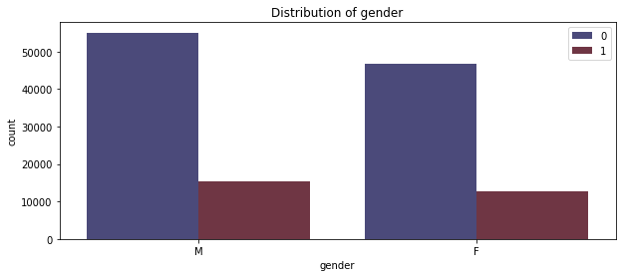
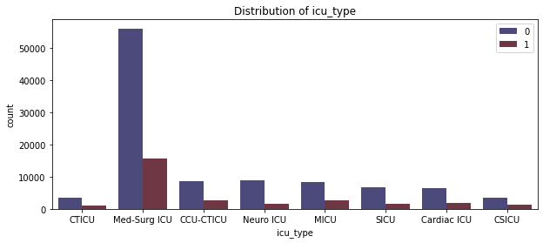
Categorical columns
It was observed that Caucasian ethnicity patients detected with diabetes, are more in number and patients under
Med-Surg ICU as well.

Slide 10
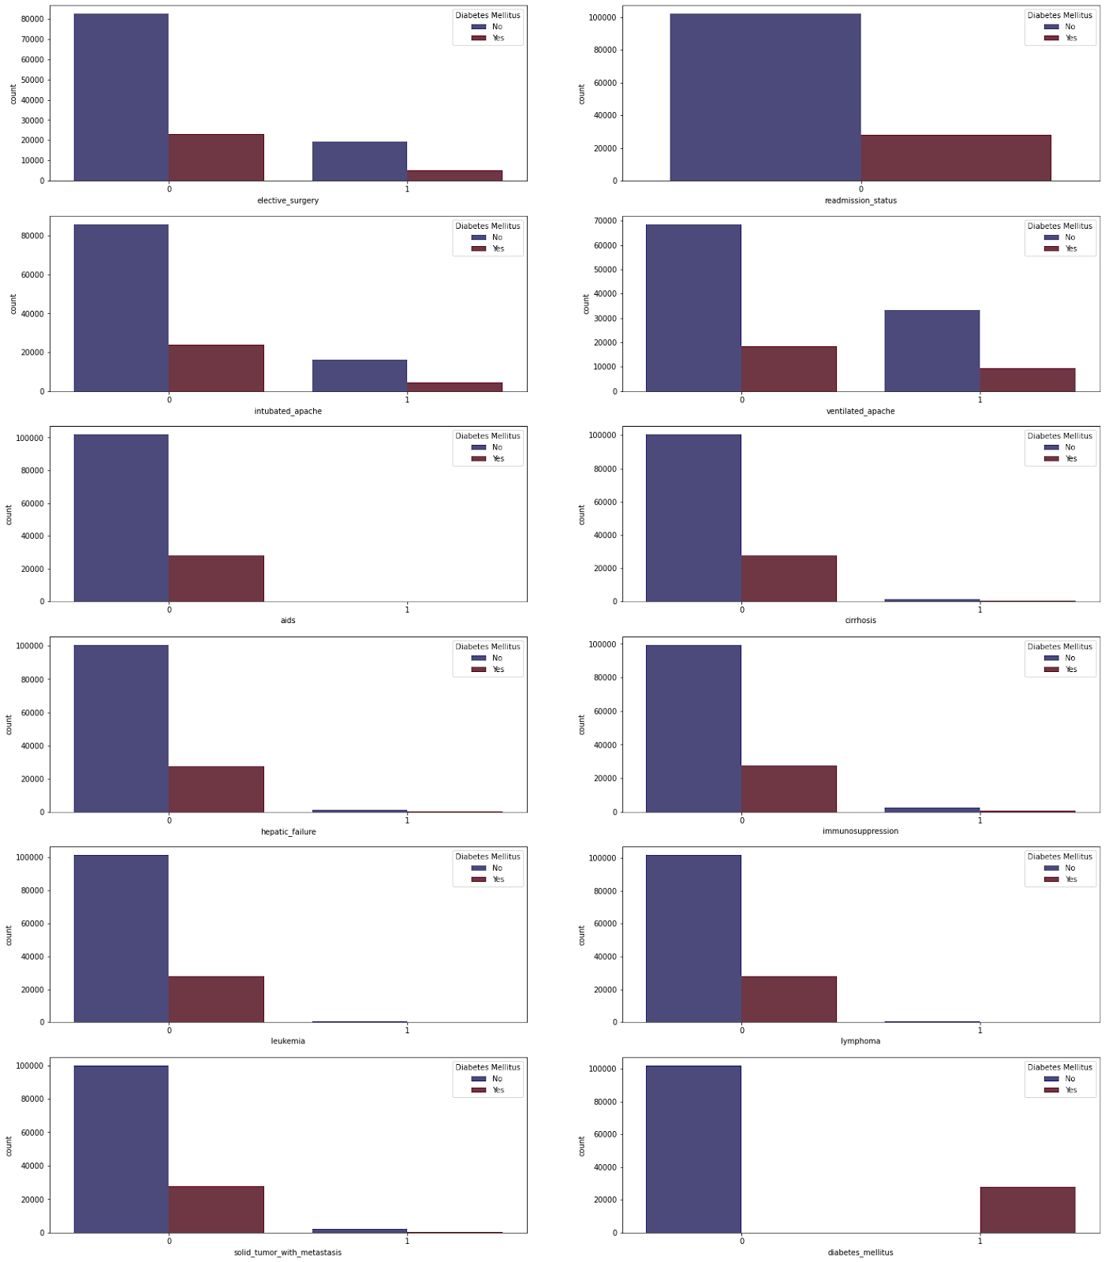
Binary Columns
Based on this graphs Columns ‘aids’, ‘cirrhosis’, ‘immunosuppression’, ‘leukemia’, and ‘lymphoma’ don't seem to exhibit any clear relation with the target column. However, we will still consider these columns until further analysis.

Slide 11
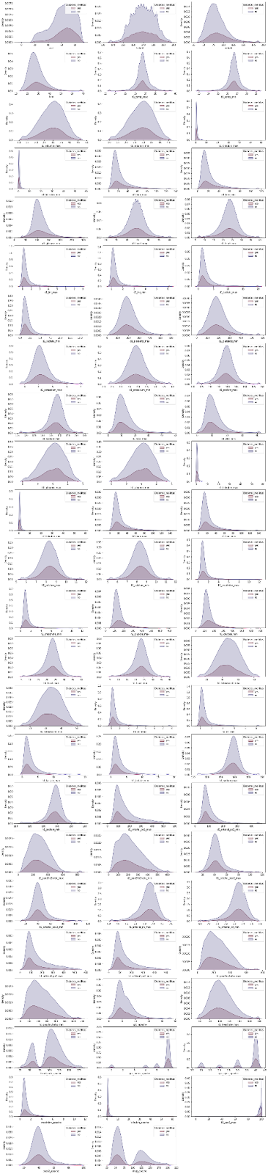
Numeric Columns
On plotting the distribution graphs for numerical variables, ‘age’, ’weight’, ‘bmi’, ‘d1_albumin_max’, ‘d1_albumin_min’, ‘d1_billrubin_max’, ‘d1_billrubin_min’, ‘d1_bun_max’, ’d1_bun_min’, ‘d1_glucose_min’, ‘d1_hco3_max’, ‘d1_hco3_min’, ‘d1_potassium_min’, ‘d1_potassium_max’, ‘d1_sodium_min’, ‘d1_sodium_max’, ‘h1_glucose_min’, ‘h1_glucose_max’, ‘heart_rate_apache’, ‘creatinine_apache’ columns seem to show relation with the target column

Slide 12
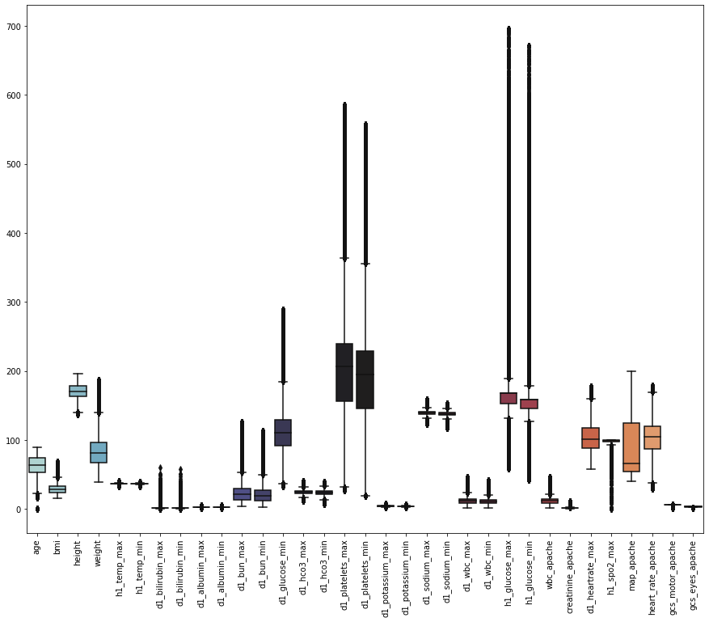
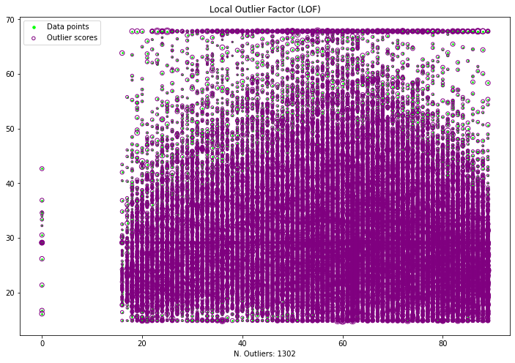
Outlier Detection
After performing outlier detection using the DBscan method we have detected 87354 rows with outliers and are left with 42803 rows and 33 columns. The results are not optimal, so we went ahead and tried other methods.
After performing outlier detection using the IsolationForest method the results are better than DBscan with 1302 outliers, 128855 rows, and 33 columns. However, we tried one more method to see if we have better results.
The Local Outlier Factor method has detected 1302 outliers which is equal to the outliers from Isolation forest method. We decided to go ahead with the Local Outlier factor method for the analysis.

Slide 13
Feature selection:
After performing and understanding the results of feature selection we have decided to take only the columns with mutual info greater than 0.003 into consideration. In doing so we ended up with 'h1_glucose_max', 'h1_glucose_min', 'd1_glucose_min', 'd1_bun_max', 'bmi', 'gcs_eyes_apache', 'd1_bun_min', 'creatinine_apache', 'weight', 'gcs_motor_apache', 'd1_bilirubin_min', 'gender', 'd1_bilirubin_max', 'ethnicity', 'age', 'd1_albumin_min', 'd1_albumin_max', 'icu_type', 'h1_temp_max', 'd1_hco3_min', 'd1_potassium_max', 'd1_sodium_min', 'h1_spo2_max', 'd1_potassium_min' columns that we will use in further analysis.

Slide 14



Upsampling Data
Training data
Downsampling Data

Slide 15


KNeighborsClassifier, SVM, DecisionTreeClassifier, and SGDClassifier
Sklearn accuracy_score
Best features using SVC
Support Vector Machine Algorithm (SVM) seems to be a good model to predict the disease diabetes mellitus for the patients. The accuracy of the model is around 76% which is pretty good to be considered.

Slide 16
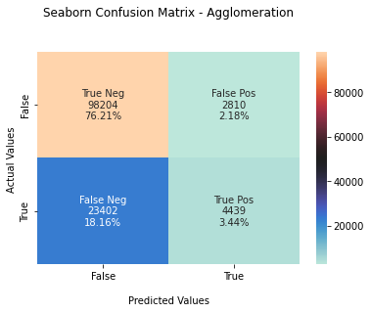
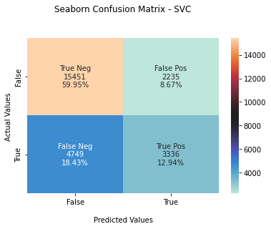
Confusion Matrix

Slide 17
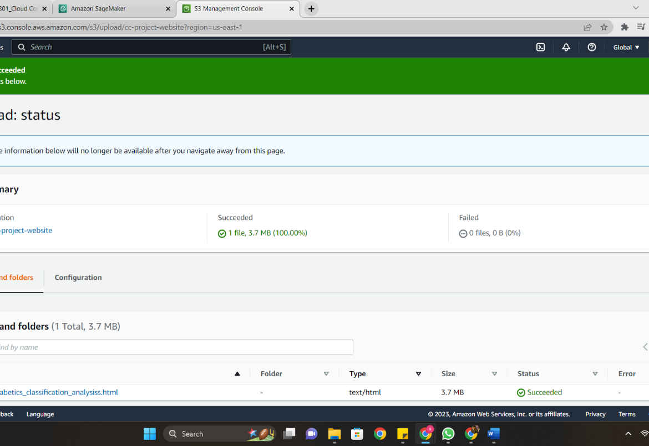
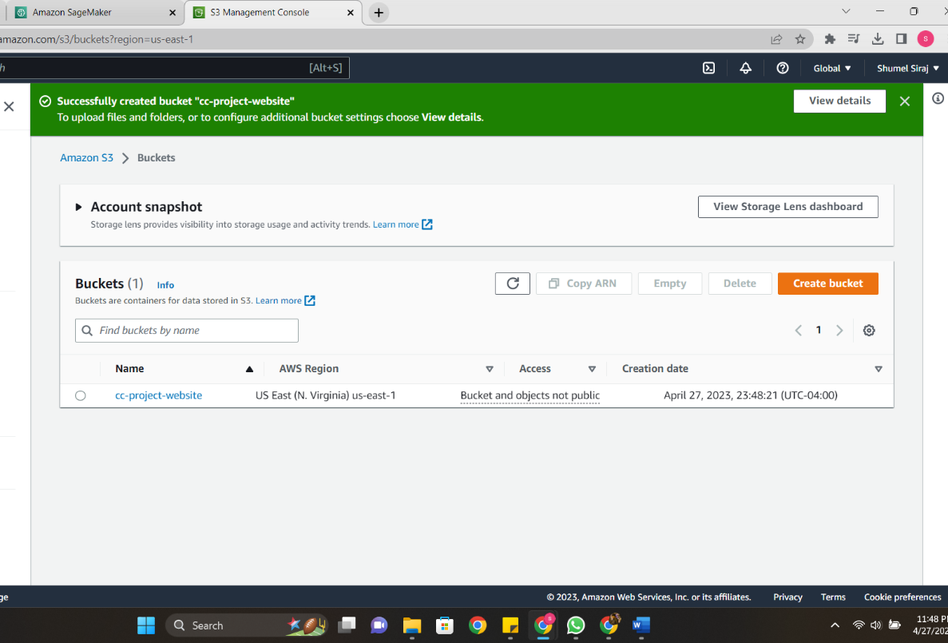
Upload HTML file to S3
Hosting the Jupyter Notebook as a Static Webpage

Slide 18
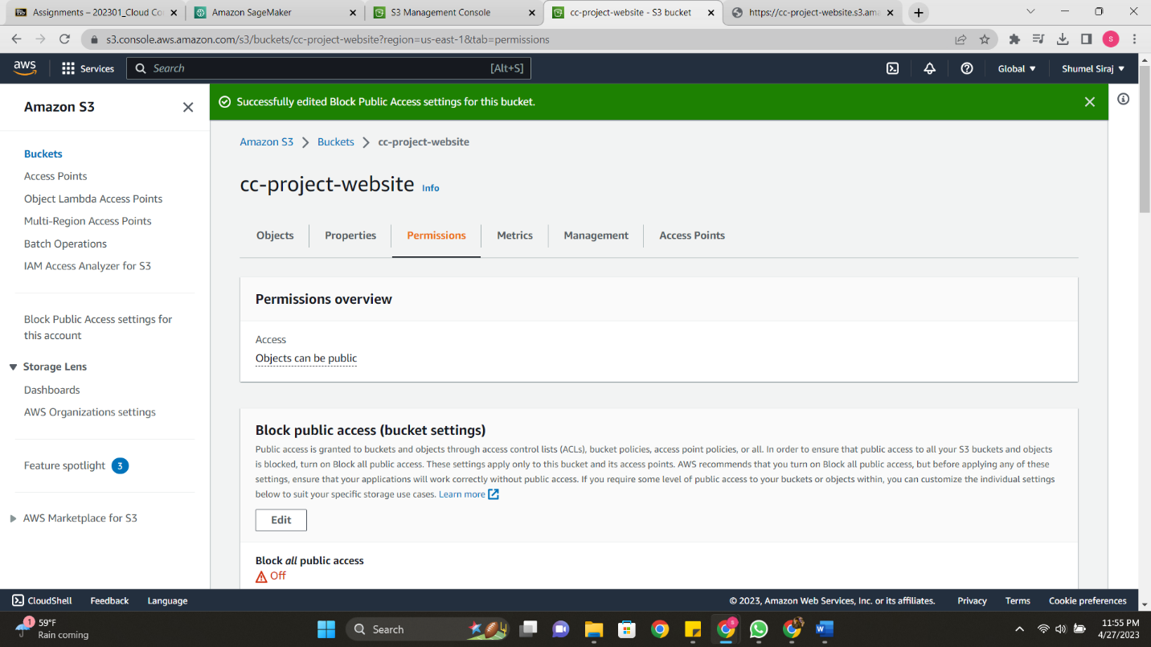
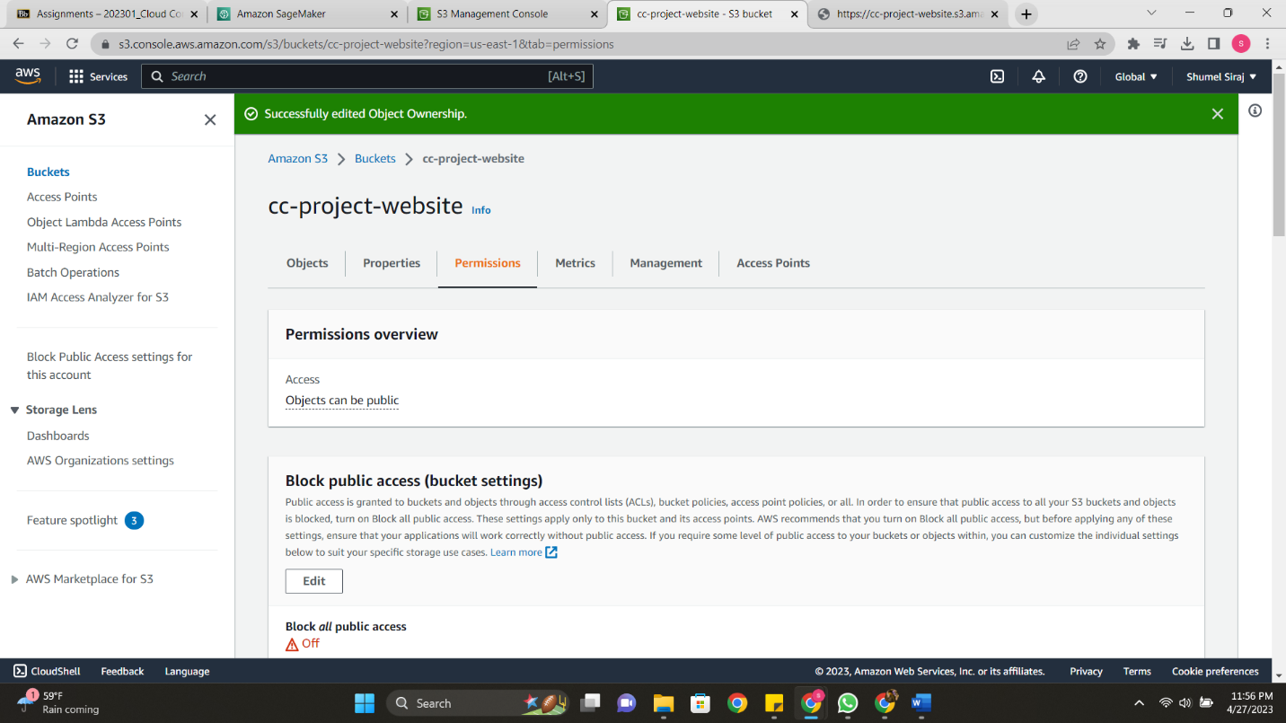
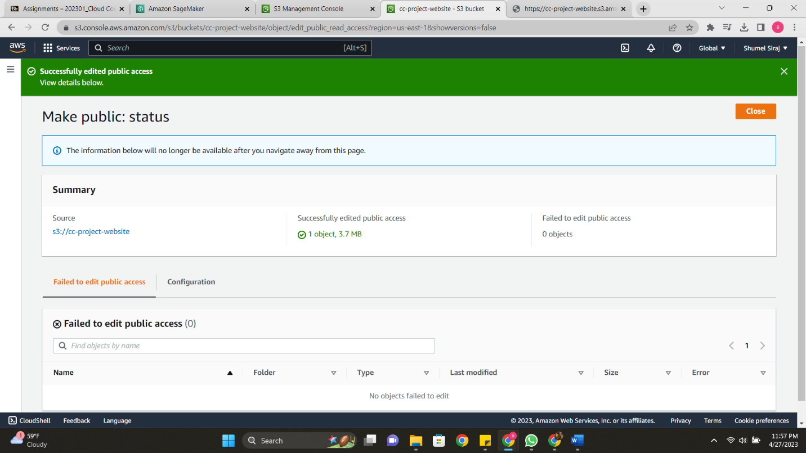
Setting permissions to host the webpage publicly

Slide 19
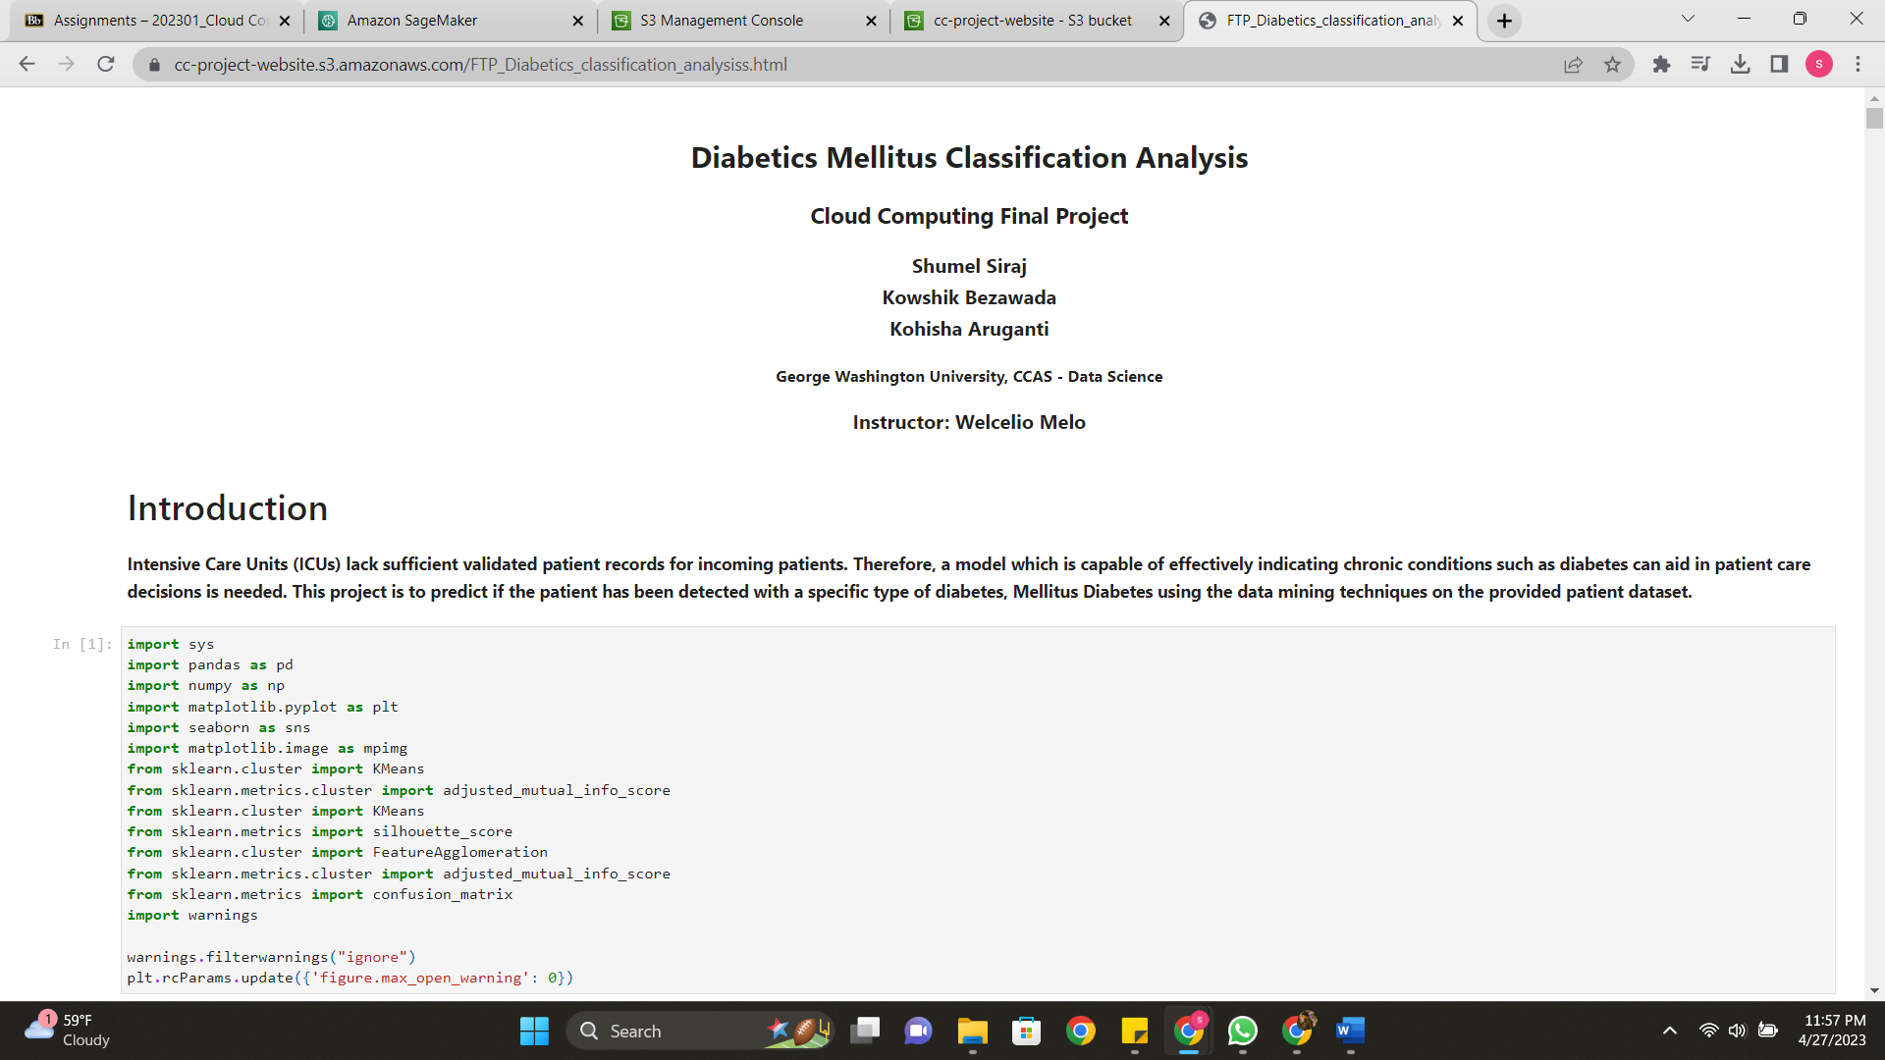
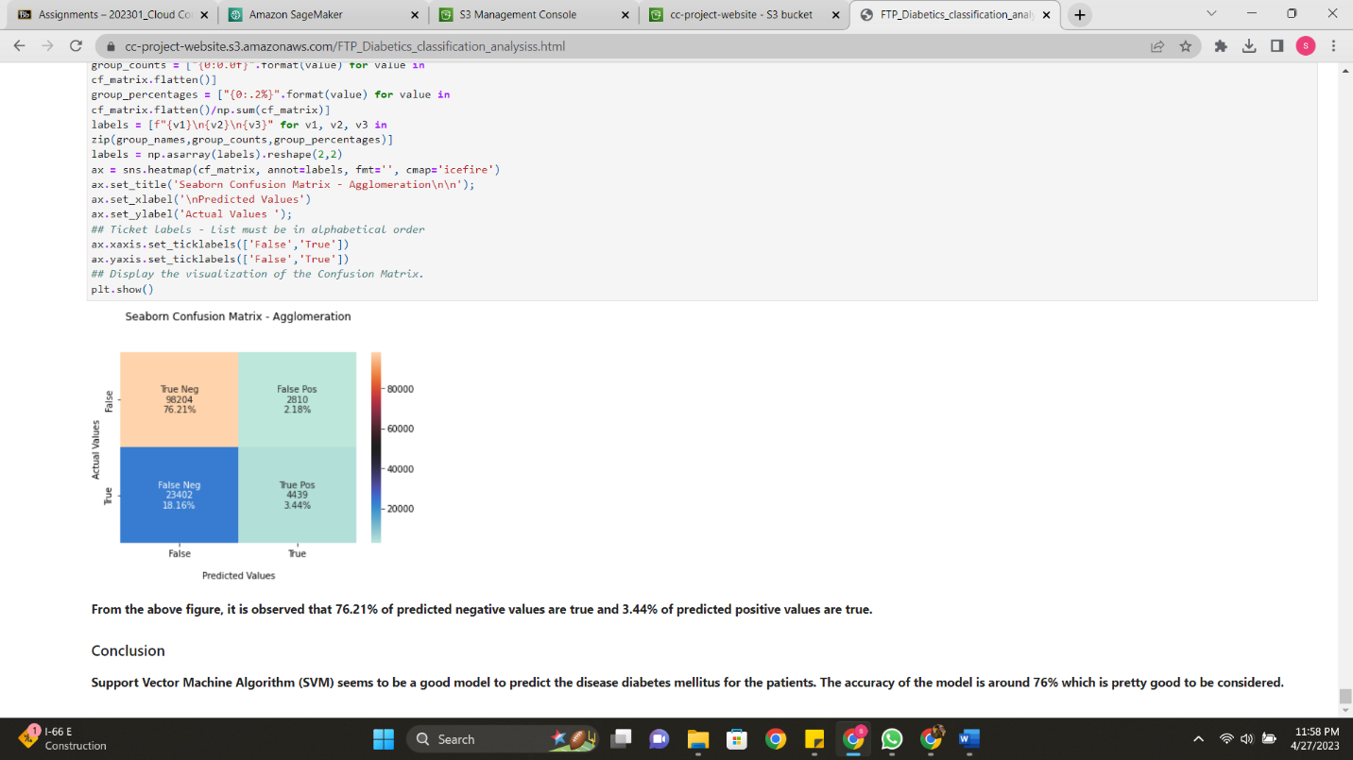
Test your webpage

Slide 20
Conclusion
We have successfully trained a Diabetes Mellitus classification using Machine Learning models on AWS SageMaker and hosted the Jupyter Notebook as a static webpage on AWS S3 by following these steps. This powerful combination enables you to create, deploy, and share machine learning models and results quickly and efficiently. By leveraging AWS services, you have streamlined the process of developing and deploying a Diabetes Mellitus classification model, making it accessible to a wider audience through a static webpage.

Slide 21
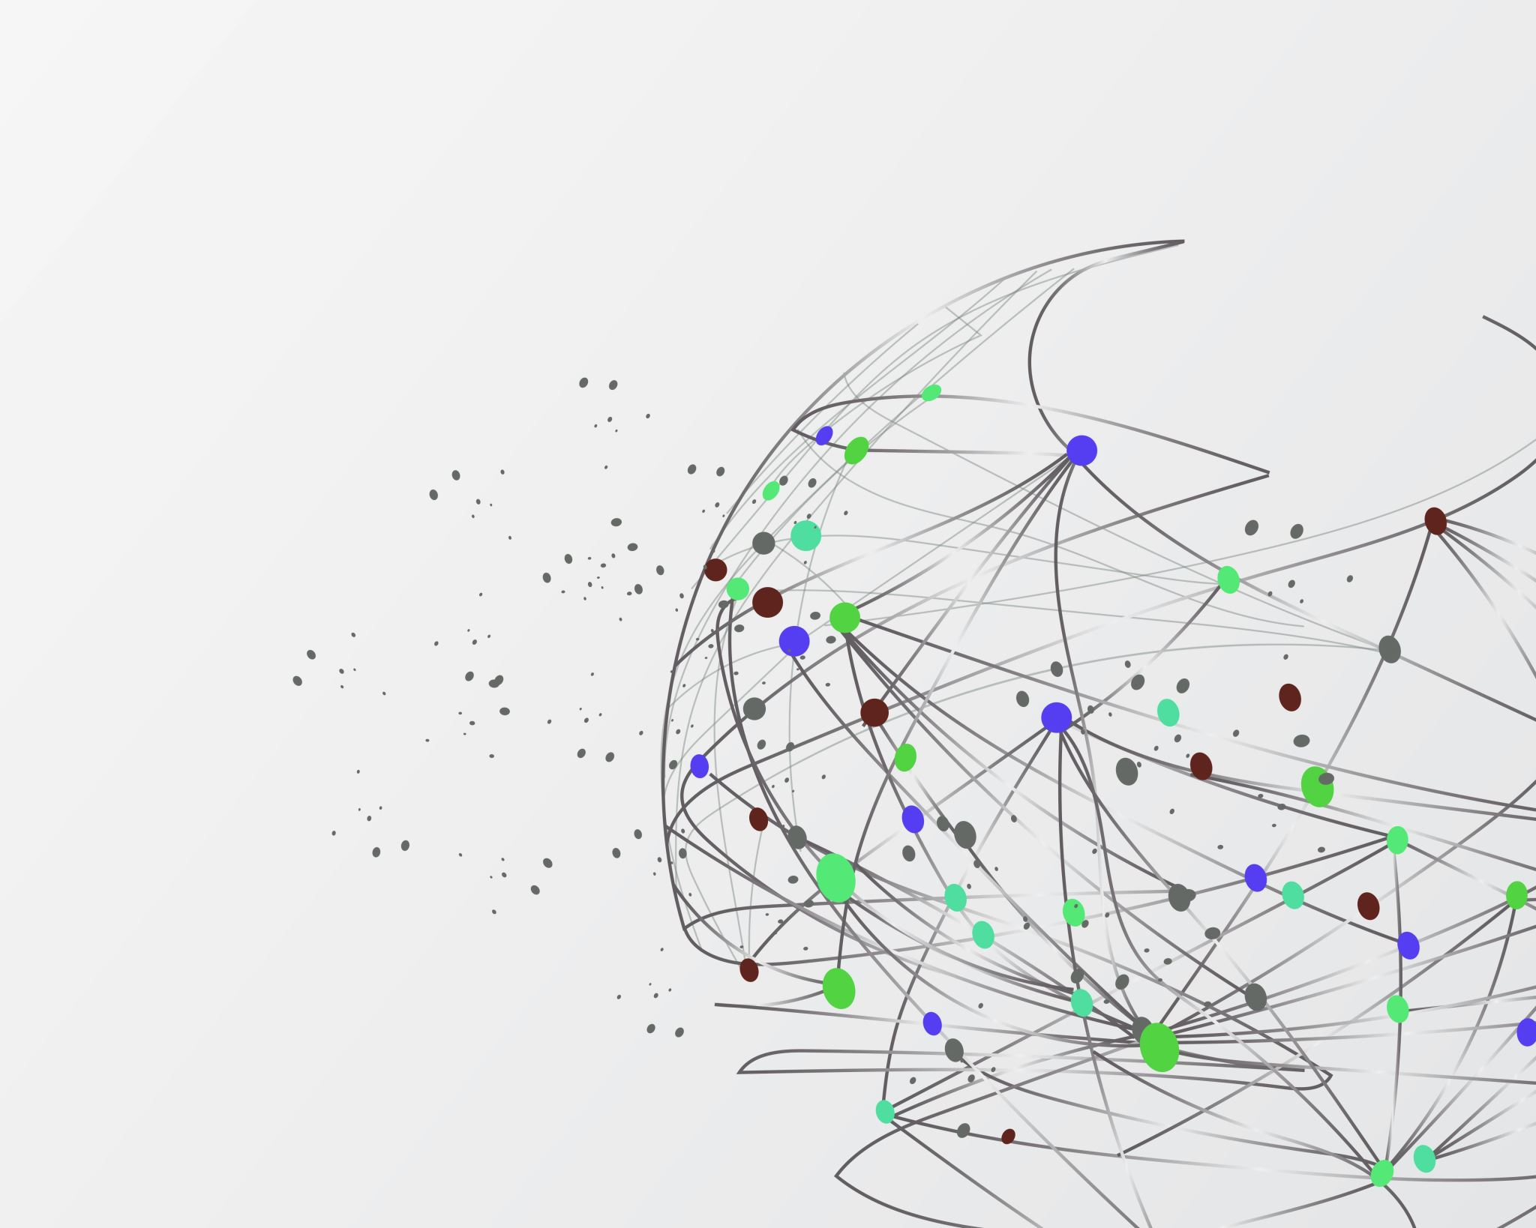
Thank You

